Slide 1
Case Study of Contemporary Abortion Fiction: Applying Right-to-Life Literary Theory to Lisabeth Posthuma’s Baby & Solo PowerPoint to Accompany Presentation for the 2022 University Faculty for Life Conference 11 June 2022 Dr. Jeff Koloze DrJeffKoloze@att.net 216-262-3511 https://www.drjeffkoloze.com

Slide 2
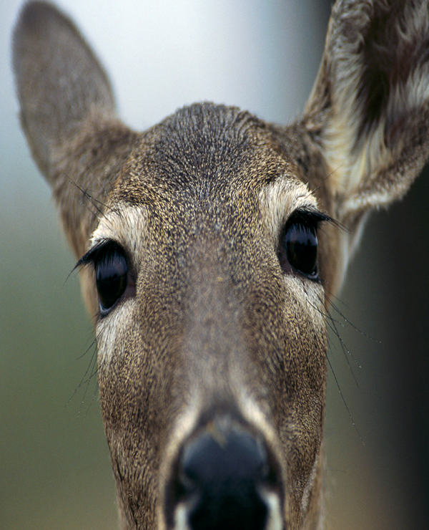
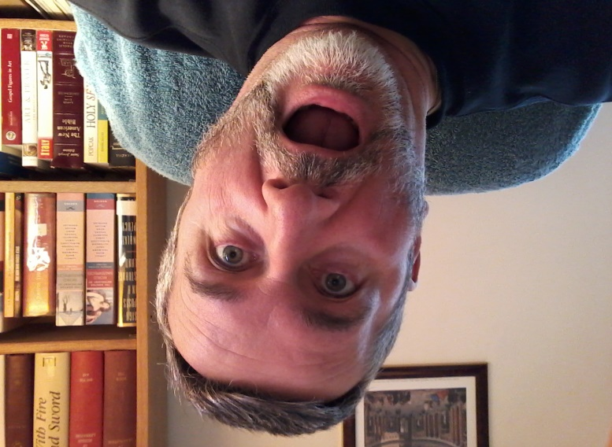
Structure of Presentation
Details of Lisabeth Posthuma’s novel Baby & Solo
Review of Contemporary Literary Theories
Application of the Five Questions of Right-to-Life Literary Theory
Questions and Answers (or Utterly Hopeless Deer-in-the-Headlight Stares from Presenter)

Slide 3
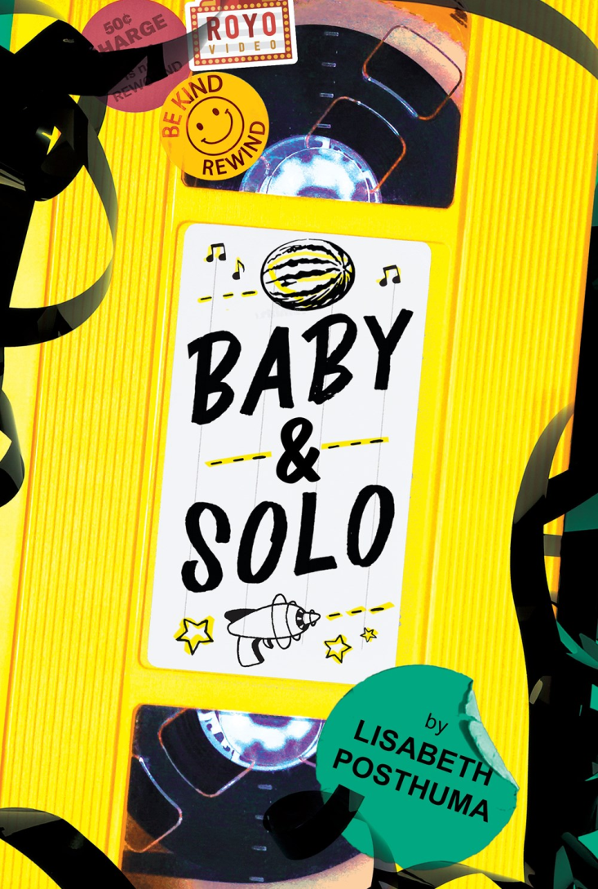
I. Details of Lisabeth Posthuma’s novel Baby & Solo
Amazon rankings:
4.8 of 5 (59 reviews)
#835,186 in the best sellers category
#1,486 in “Teen & Young Adult LGBTQ+ Fiction”
#1,052 in “Teen & Young Adult Fiction about Death & Dying”
#507 in “Teen & Young Adult Fiction on Depression & Mental Health”
Goodreads.com: 4.38 of 5 (504 ratings)

Slide 4
II. Review of Contemporary Literary Theories
Archetypal/Jungian Criticism
Biographical Criticism
Critical Disability Studies
Critical Race Theory
Deconstruction
Feminist Literary Criticism
Formalism
Gender Criticism (Gay and Lesbian or Queer Studies)
Historical Criticism
Marxist Literary Criticism
Psychoanalytic Criticism
Reader-Response Criticism

Slide 5
II. Posthuma’s “Press Bio 1”
Lisabeth Posthuma is a devotee of obscure documentaries about drive-ins, a lover of rotary telephones, and a trophy-winning champion of TV trivia. She lives in Michigan with her two parakeets, Tiki Bon Jovi and Alaska Riggins. Her favorite story is probably Frankenstein. (“Media”)

Slide 6
II. Posthuma’s “Press Bio 2”
Lisabeth Posthuma was a high school teacher, a photographer, and most importantly, a video rental clerk before becoming a writer. She holds an English degree from one of those really expensive private liberal arts colleges that no one can afford (including her). She grew up obsessed with teen soaps, which her therapist says explains a lot, and likes to brag about that one time she attended the cast party for The OC. Orange is her favorite color because in first grade no one chose it, and she felt sorry for it. She currently lives in Michigan where the winters are too long. (“Media”)

Slide 7
II. Posthuma on Abortion in YA Fiction
Knowing abortion affects so many people who make up the young adult demographic, it’s a disservice not to acknowledge the subject’s necessary place in YA media. Though public discourse about abortion continues to be divisive and heated, young adult content creators can provide our audiences with low-stakes avenues through which to wrestle with their difficult feelings about difficult subjects. Realistic fiction is a valuable gateway to rediscovering the lost art of uncertainty, for recognizing the gray within the false narrative of a black-and-white world. In fact, it might be the most fertile soil for empathy to grow in. (Jensen)

Slide 8
II. Posthuma on Abortion in YA Fiction
I’m learning that the hypothetical is the safest space to feel unsure. It’s seemingly the only place where there’s no urgency to form the “right” opinion. It’s where people can privately challenge their own thoughts, explore nuances, and ultimately grow in their understanding about the issues that affect them. I wish that at thirteen I’d had more safe places to contemplate issues like abortion, but I didn’t. As an adult, however, I’m grateful that I can join with other writers who want [to] change things for this generation’s YA audience. I am hopeful that as abortion continues to be a relevant subject, even more authors will seize the opportunity to create these spaces for teens, too. (Jensen)

Slide 9
II. Various Excerpts (Posthuma, Baby)
“It wrecked me. It broke me in half. And it ruined my fucking life” (368)
"What kind of morals would I have if I made a girl take a cab to her own abortion?” (59)
“Somehow this was enough information for Baby to figure out the answer, because a few seconds later she said, ‘Oh’” (44)
“…the girl you sometimes hallucinate is more in line with a schizoaffective disorder” (45)
“After a few minutes outside in subzero temperatures, my balls retracted into my body, and I was able to think about what had just happened with my brain instead of my dick” (unpaginated 260)

Slide 10
III. Application of the Five Questions of Right-to-life Literary Theory
1. Does the literary work support the perspective that human life is, in the philosophical sense, a good, some “thing” which is priceless?
2. Does the literary work respect the individual as a being with inherent rights, the paramount one being the right to life?
3. If the literary work covers the actions of a family, does it do so respecting heterosexual normativity and the integrity of the family?
4. Does the literary work comport with the view that unborn, newborn, and mature human life has an inherent right to exist?
5. When they are faced with their mortality, do the characters come to a realization that there is a divine presence in the world which justifies a life-affirming perspective?

Slide 11
II. Various Excerpts (Posthuma, Baby)
“I think I'm going to feel lonely afterward, once it's gone” (275)
“…the godawful amount of pain will be all the clue I need that the person inside of me is trying to break out” (264)
“Was that a kick?”
“Or an elbow. I can never tell.”
I was completely amazed. “It has elbows?” I looked down at Baby’s stomach and then back at her face. “There are elbows in there?” (274)
“Did they not show you the Miracle of Life video in homeschool?” (275)
"an impossibly small human”; “such a small person” (341-2)

Slide 12
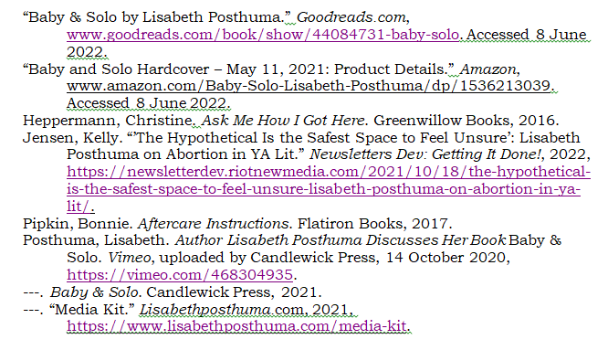
Works Cited

