Slide 1
Contemporary Literary Theories,
Problems with Those Theories, and
Why Students of Literature Will Benefit from
Right-to-Life Literary Theory
PowerPoint to Accompany Presentation for the 2021 LifeTech Conference
30 October 2021
Dr. Jeff Koloze
DrJeffKoloze@att.net
216-262-3511

Slide 2

Structure of Presentation
Review of contemporary literary theories
Problems with contemporary literary theories
Right-to-life literary theory
Applications of right-to-life literary theory to representative literature on the three life issues
  Nicki Minaj’s “Autobiography” (abortion song)
  Thomas Rydahl’s The Hermit (infanticide novel)
  Family Guy’s Teri Schiavo episode (euthanasia)
Questions and answers or utterly hopeless deer-in-the-headlight stares from presenter

Slide 3
I. Review of Contemporary Literary Theories
Archetypal or Jungian Criticism
Biographical Criticism
Critical Disability Studies
Critical Race Theory
Deconstruction
Feminist Criticism
Formalism and New Criticism
Gender Criticism/Gay and Lesbian or Queer Studies
Historical Criticism
Marxist Criticism
Moral Criticism, Dramatic Construction
New Historicism/Cultural Studies
Postcolonial Criticism
Post-Structuralism
Psychoanalytic Criticism
Reader-Response Criticism
Structuralism/Semiotics

Slide 4
II. Problems with Contemporary Literary Theories
Archetypal or Jungian Criticism
Biographical Criticism
Critical Disability Studies
Critical Race Theory
Deconstruction
Feminist Criticism
Formalism and New Criticism
Gender Criticism/Gay and Lesbian or Queer Studies
Historical Criticism
Marxist Criticism
Moral Criticism, Dramatic Construction
New Historicism/Cultural Studies
Postcolonial Criticism
Post-Structuralism
Psychoanalytic Criticism
Reader-Response Criticism
Structuralism/Semiotics

Slide 5
III. Right-to-life Literary Theory
1. Does the literary work support the perspective that human life is, in the philosophical sense, a good, some “thing” which is priceless?
2. Does the literary work respect the individual as a being with inherent rights, the paramount one being the right to life?
3. If the literary work covers the actions of a family, does it do so respecting heterosexual normativity and the integrity of the family?
4. Does the literary work comport with the view that unborn, newborn, and mature human life has an inherent right to exist?
5. When they are faced with their mortality, do the characters come to a realization that there is a divine presence in the world which justifies a life-affirming perspective?

Slide 6

IV. A. Nicki Minaj’s “Autobiography”
Image credit: clip art.

Slide 7
IV. A. Excerpt from Nicki Minaj’s “Autobiography”
Please baby forgive me mommy was young mommy was too busy trying to have fun now I pat myself on the back for sending you back cause God knows I was better than that to conceive you then leave you the concept alone seems evil I'm trapped in my conscience I adhere to the nonsense listened to people who told me I wasn't ready for you but how the fuck would they know what I was ready to do and of course it wasn't your fault it's like I feel you in the air I hear you saying mommy don't cry can't you see I'm right here I gotta let you know what you mean to me when I'm sleeping I see you in my dreams with me wish I could touch your little face or just hold your little hand if it's part of God’s plan maybe we can meet again
Lyrics transcribed from the song (see Works Cited); capitalization and homophonic errors corrected.

Slide 8
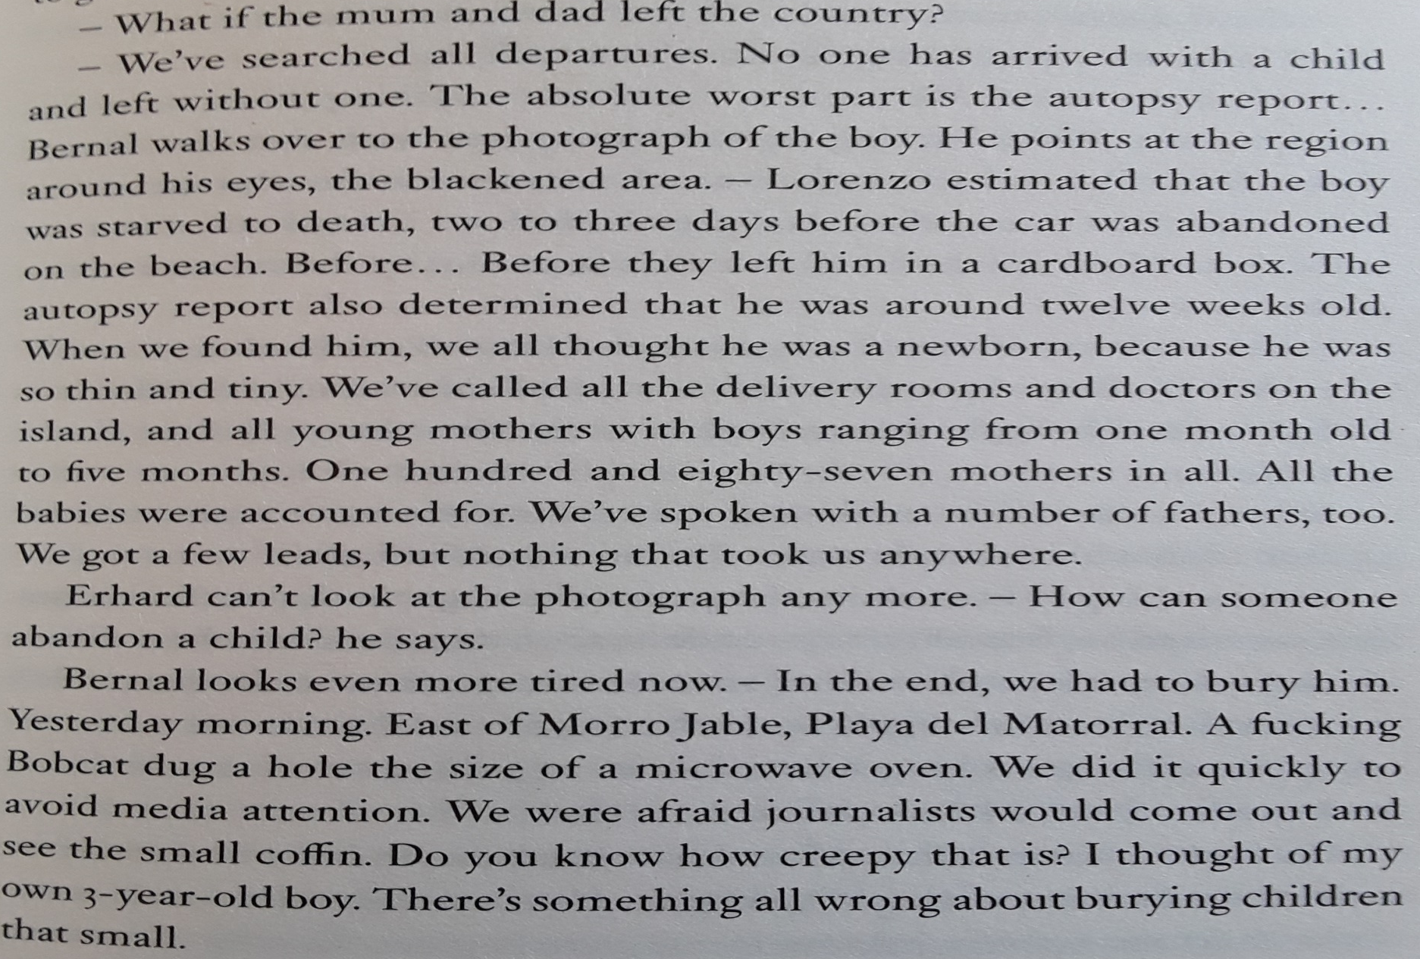
IV. B. Thomas Rydahl’s The Hermit (2016)
(Rydahl 51)

Slide 9
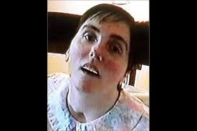
IV. C. Family Guy’s Teri Schiavo episode (pt. 1)
Child 1 (Michael Schiavo): Hi Doctor, it's me, Michael Schiavo. How's my wife doing?
Child 2 (Doctor): She's a vegetable.
Child 3 (Doctor): I hate vegetables.
(laughter)
Child 2 (Doctor): Don't worry about her, Mr. Schiavo. She's being kept alive by medical science.
Child 1 (Michael Schiavo): Gee, look at all this stuff. How does it all work?
Child 2 (Doctor): Well, I'll tell you.
This one keeps her liver clean.
This one checks her pee.
Child 1 (Michael Schiavo): How about this one over here?
Child 2 (Doctor): Oh, that's just the TV.
Chorus: Ha ha ha

Slide 10
IV. C. Family Guy’s Teri Schiavo episode (pt. 2)
Child 2 (Doctor):] This one checks her heart rate.
This one checks her veins.
And this dispenses gravy for her mashed potato brains.
Chorus: Oh oh oh
Terri Schiavo is kind of alive-o.
What a lively little bugger.
Bass child doctor: Maybe we should just unplug her.
Chorus: Terri Schiavo is kind of alive-o.
The most expensive plant you'll ever see.
[….]
Child 1 (Michael Schiavo): There's only one solution.
It's in the Constitution.
We've got to pull the plug! (“Terri Schiavo: The Musical”)

Slide 11
IV. C. Family Guy’s Teri Schiavo Euthanasia Episode
Child 1 (Michael Schiavo): Hi Doctor, it's me, Michael Schiavo. How's my wife doing?
Child 2 (Doctor): She's a vegetable.
Child 3 (Doctor): I hate vegetables.
(laughter)
Child 2 (Doctor): Don't worry about her, Mr. Schiavo. She's being kept alive by medical science.
Child 1 (Michael Schiavo): Gee, look at all this stuff. How does it all work?
Child 2 (Doctor): Well, I'll tell you.
This one keeps her liver clean.
This one checks her pee.
Child 1 (Michael Schiavo): How about this one over here?
Child 2 (Doctor): Oh, that's just the TV.
Chorus: Ha ha ha
Child 2 (Doctor):] This one checks her heart rate.
This one checks her veins.
And this dispenses gravy for her mashed potato brains.
Chorus: Oh oh oh
Terri Schiavo is kind of alive-o.
What a lively little bugger.
Bass child doctor: Maybe we should just unplug her.
Chorus: Terri Schiavo is kind of alive-o.
The most expensive plant you'll ever see.
[….]
Child 1 (Michael Schiavo): There's only one solution.
It's in the Constitution.
We've got to pull the plug! (“Terri Schiavo: The Musical”)

Slide 12
Works Cited
“Nicki Minaj--Autobiography (Official Music Video).” YouTube, YouTube, 6 Apr. 2013, https://www.youtube.com/watch?v=nHbFm6UfCX4.
Rydahl, Thomas. The Hermit (Oneworld Publications, 2016).
“Terri Schiavo: The Musical.” Family Guy Wiki, https://familyguy.fandom.com/wiki/Terri_Schiavo:_The_Musical.
Questions and Comments:
DrJeffKoloze@att.net
https://www.drjeffkoloze.com/

