Slide 1
Transgender Fiction and the Right-to-Life Issues:
A Study of Recent Transgender Fiction on Abortion and Euthanasia
Using Right-to-Life Literary Theory
PowerPoint to Accompany Presentation for the annual conference of the
Society of Catholic Social Scientists
29 October 2022
DrJeffKoloze@att.net
216-262-3511

Slide 2
Scholarly and Other Commentary on a
Transgender and Abortion Connection
Abortion isn’t a women’s rights issue. It’s a human rights issue, and we need to address it as such. Nonbinary, transgender, and agender folks, as well as those who identify outside those labels who can get pregnant deserve to be heard in this discussion, too. Their already-marginalized bodies and experiences are only further harmed with the language we use to discuss abortion. It’s not a decision between a woman and her doctor. It’s a decision between a pregnant person and their doctor or other healthcare worker who can do the procedure. (Kelly)
Gender identity can be consistent with or different from the sex that someone was assigned at birth. Sex assigned at birth is typically based on external genitalia, and is recorded as female, intersex, or male. “Transgender” is an umbrella term for people whose gender identity differs from the sex assigned to them at birth, while “cisgender” is a term for people whose gender identity aligns with their sex assigned at birth. (Moseson et al. 2)

Slide 3
Scholarly and Other Commentary on a
Transgender and Abortion Connection
How are social and cultural geographers leading work to understand the diversity of bodies in relation to reproductivity to better account for the diversity of gender experiences among pregnant people? Research on abortion often uneasily navigates the tensions of gender diversity and fluidity. Restrictions on abortion access are widely understood as gender-based discrimination against women, but not all pregnant people self-identify as women. Moreover, trans and non-binary pregnant people often face the greatest vulnerability in accessing reproductive care. Geographers should do more to account for the intersection of gender with other axes of inequality including sexuality, class, ability, and race in abortion access. (Calkin and Freeman 1329-30)
Abortion has also figured prominently in feminist politics, activism and theorizing. Yet as gender binaries are deconstructed in dialogue with queer theory and movements, the meaning of “woman” and “man” cannot be taken for granted, and contemporary abortion politics reflects these contestations. There have been increasing calls in activist spaces to “queer” abortion rights advocacy, to incorporate non-normative understandings of gender identity and sexuality into abortion struggles and services. ([Sutton and Borland 1378])

Slide 4
III. Right-to-life Literary Theory
1. Does the literary work support the perspective that human life is, in the philosophical sense, a good, some “thing” which is priceless?
2. Does the literary work respect the individual as a being with inherent rights, the paramount one being the right to life?
3. If the literary work covers the actions of a family, does it do so respecting heterosexual normativity and the integrity of the family?
4. Does the literary work comport with the view that unborn, newborn, and mature human life has an inherent right to exist?
5. When they are faced with their mortality, do the characters come to a realization that there is a divine presence in the world which justifies a life-affirming perspective?

Slide 5

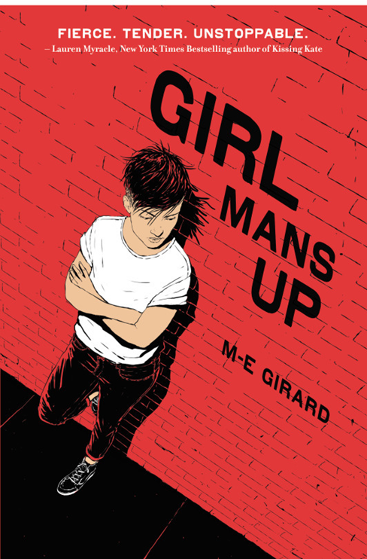
Vickie Weaver’s Billie Girl (2010) and M-E Girard’s Girl Mans Up (2016)
Images credit: Goodreads.com

Slide 6
Quotes from the Novels
"a boyish, video-game-playing girl” (Girard 2)
"We do what we have to do" (Weaver 132)
"a jerk just trying to get laid" (Girard 8)
"Getting in their pants isn't worth it" (Girard 29)
"I just wanna have fun and get laid" (Girard 30)
“A man’s gotta do what he’s gotta do” (Girard 130)
“I had never wanted to be a mother” (Weaver 132)
“It kind of bugs me that I have to blow up dogs” (Girard 32)
“I kind of feel like crap for destroying their home and murdering them” (Girard 51)

Slide 7

Girard’s Girl Mans Up (2016)
“It’s like one second, I should be a better dude. I should stop being such a girly douche, and I should just man up. Then, it’s the opposite: I’m too much of a guy, and it’s not right. I should be a girl, because that’s what I’m supposed to be” (42)
“I don’t think of myself as being gay, because that word sounds like it belongs to some guy. Lesbian makes me think of some forty-year-old woman. And queer feels like it can mean anything, but like—am I queer because I like girls, or because I look the way I do? Maybe I don’t know enough words.” (65; italics in original)
Image credit: Goodreads.com

Slide 8
Quotes from the Novels
"there’s a baby inside Olivia’s stomach" (Girard 190)
"start looking...you know?" (Girard 117)
“You’re going to get an abor—” (Girard 118)
“Say you wanted to decide stuff. I just don’t think letting him in your head would help. Things would get all twisted and confused” (Girard 161)
"I think maybe you shouldn’t think about doing what’s right, and maybe you should just do what feels less wrong "(Girard 193; italics in original)
“was hoping the whole thing just went away" (Girard 242)

Slide 9
Girard’s Girl Mans Up (2016)
“You don’t have to feel bad for having done it, but I think you might end up feeling bad about something, anything. Like feeling bad you could never tell your mom, or feeling bad you didn’t get the pill, or feeling bad for liking Colby, or…anything really.” (269; ellipsis in original)
“I want to ask her if she regrets it, the abortion” (286)
“They’re people you threw away” (318)
Image credit: Goodreads.com

Slide 10
Girard’s Girl Mans Up (2016)
I'm full of bad feelings.
Not because I feel guilty, or because I regret what I’ve done, though. It’s like I keep telling Olivia when she thinks about the abortion: it’s okay to feel bad about how things went down, but it’s not okay to drown in guilt and regret every day for having made decisions other people don’t agree with. At some point, we all have to man up and decide to do what we have to do, despite the people around us who try to get in the way. (353)
Image credit: Goodreads.com

Slide 11

Weaver’s Billie Girl (2010)
"other old, useless, decomposing human beings—most of them not in their right minds" [221]
“Though I had helped Grandma meet her Maker, it took me being life-wounded myself to understand the mercy of killing” [221]
"The next two residents I sent on their way" (225)
"She had pooped in the bed" (228)
“I covered up and shoved my hands into my sweater pockets to keep warm. Out of habit, my fingers groped around. I came across two pills in the right-hand pocket. Two pills” (231)
Image credit: Goodreads.com

Slide 12
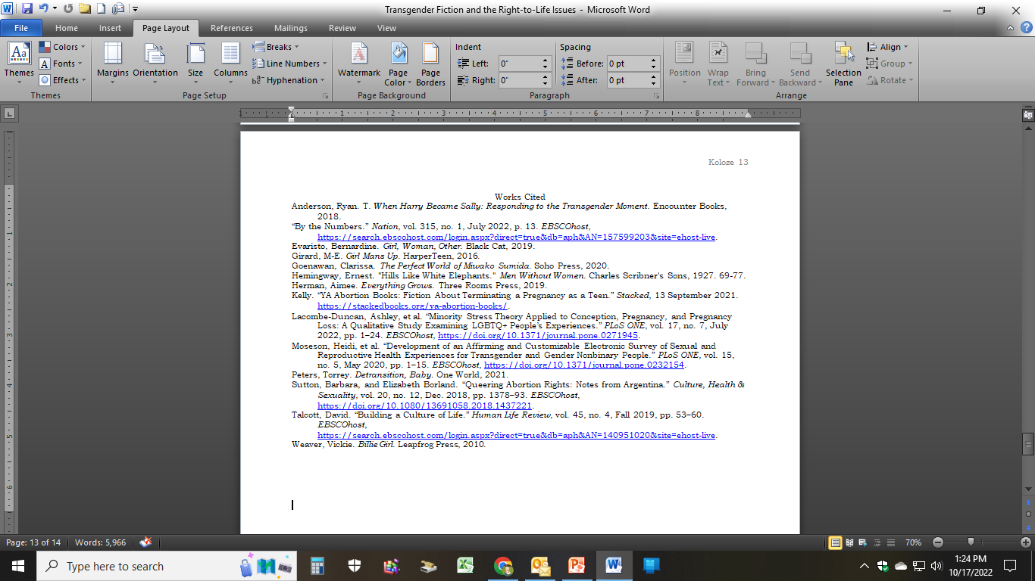
Works Cited
Questions and Answers

